Slide 1

Team – 3141 Aggre-Gator
Anuj Koli
Anurag Shenoy
Ruchika Upadhyay
Naveen Kumar
Aman Pathak

Slide 2
Introduction
This application uses AWS to perform long text searches on news articles on different newspaper websites to find the common news article and deliver them onto a single webpage.
In the First prototype, we are focusing on two popular news channels Fox News and CNN News.
The novelty of the project is that it focuses more on recent news and provides control to the user to choose which news source should he choose to read the article.
Notes:
Running Example can be of a Home Automation system.

Slide 3
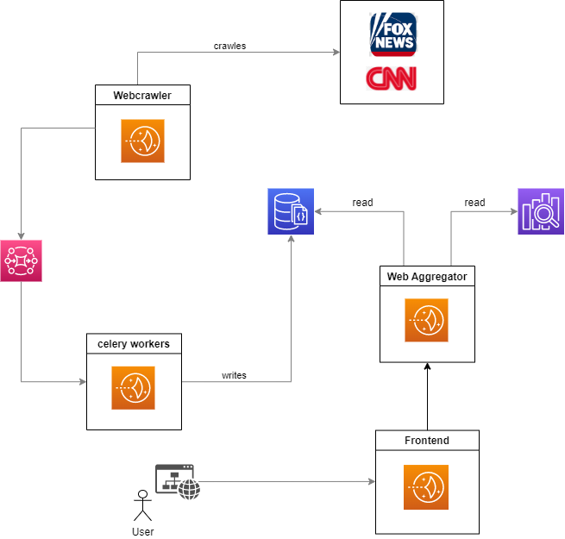
Architecture
Notes:
Published in: 1st international symposium on Handheld and Ubiquitous Computing (HUC conference in 1999).

Slide 4
Frontend
Three Options – Home, Sources, Categories
Eight categories – Health, World, US, Business, Technology, Entertainment, Travel, Politics.
Two Sources – CNN News and Fox News.
Frontend is written in Python using Flask.

Slide 5
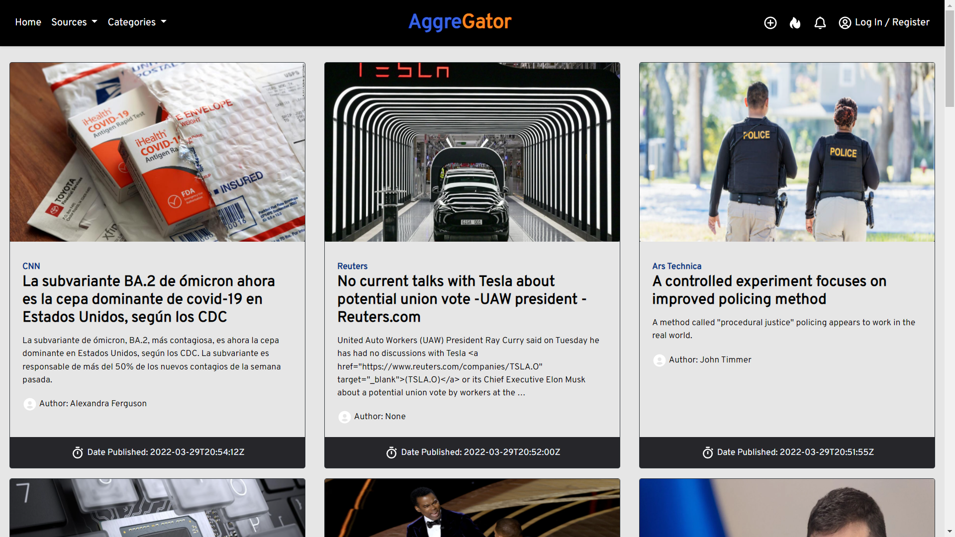

Slide 6
Backend
Flask is also used in Backend.
Using beautiful soup, urllib and requests for web scraping.
We are using Elastic Search to store the scraped fox news and CNN news articles for high performance text searching.
Extract all the details of the news source like title, author, image, content etc.
Notes:
We implicitly know that we want to turn on the lights in the evening and turn them off before bed.
A good Home automation system will make use of such context (time and location).

Slide 7
Working
The web scraper extracts all the information like content, author, title, and image from the news source and the frontend will display them according to the defined format.
We are using DocumentDB as a permanent data store to store the articles as documents.
Notes:
Ex for pt 1: Entering identity information during Signup
Ex for pt 2: Collecting location data for customizing service like for Netflix or Amazon Prime.

Slide 8
Future Proposal
Log in and ML algorithm for user searched data to show relevant content as soon as the user opens the website.
Integration with Alexa Search History which deals with the news.
Notes:
These definitions that define context by example are difficult to apply.
Zoom detecting you are muted and letting you know.

Slide 9





TEAM
Koli Anuj 25 The University of Florida(MS) | Anurag Shenoy 26 The University of Florida (MS) | Aman Pathak 24 The University of Florida (MS) | Ruchika Upadhyay 27 New York University (MS) | Naveen Kumar 25 New York University (MS)

Slide 10
Thank You! Questions?

